Slide 1
Lead Score Case Study (Logistics Regression)
By Aishwariya, Abhijeet &Manish.K
Email- ashwariyasah2036@gmail.com
abhijeetsinghpanwar95@gmail.com
manish.aryan4@gmail.com

Slide 2
Problem Statement
X Education is an organization which provide online courses for industry professional. There presence on major online website like Google.
They want to select most promising leads that can be converted to paying customers. But in all those process only 30% leads convert in pay customer.
Now we will help to find out concerning point & implement make course of action for higher success rate.

Slide 3
Objectives
The company requires a model to be built for selecting most promising leads.
The model to be built in lead conversion rate around 80% & more from 30%.

Slide 4
Steps
Data Collection
Data Mining( Cleaning & prepare for analysis)
Apply EDA for figure out most helpful attributes for conversion
Scaling Features
Build Model( Logistics Regression)
Test the model on train data set
Evaluate Model on different required parameters
Test the model on data set
Measure accuracy of the model
Conclusion

Slide 5
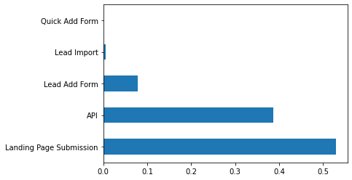
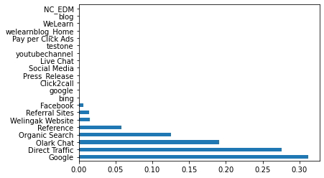
EDA- UNIVARIATE ANALYSIS LEAD ORIGIN VS LEAD SOURCE

Slide 6
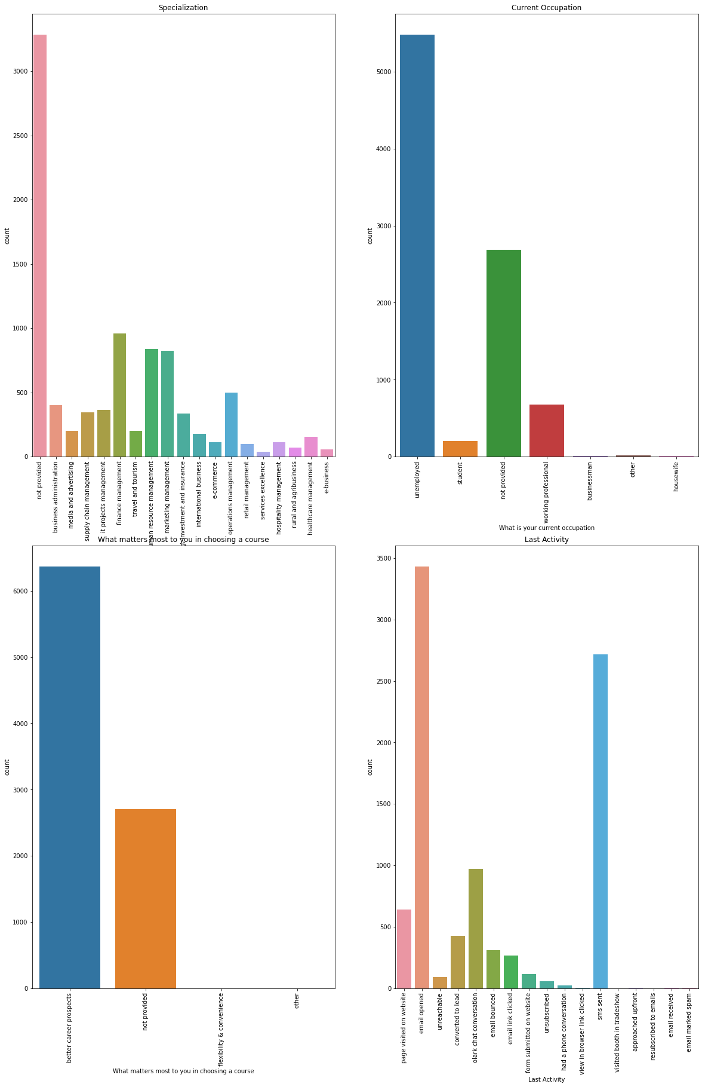
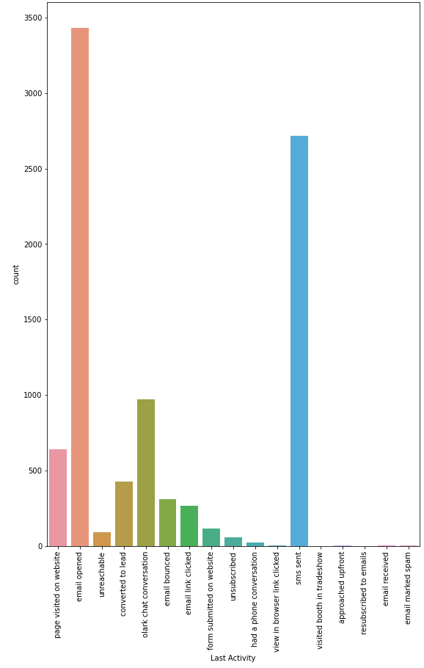
EDA- UNIVARIATE ANALYSIS OPTING COURSE VS LAST COURSE OF ACTION

Slide 7
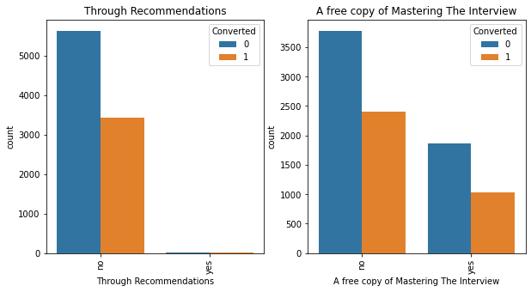
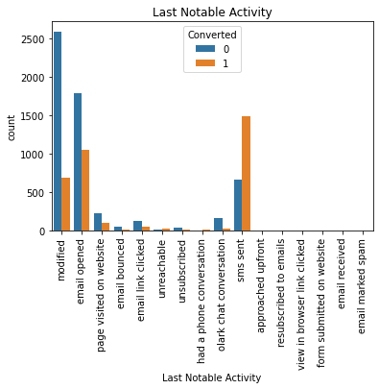
EDA- BIVARIATE ANALYSIS CONVERSION COMPARIOSN

Slide 8
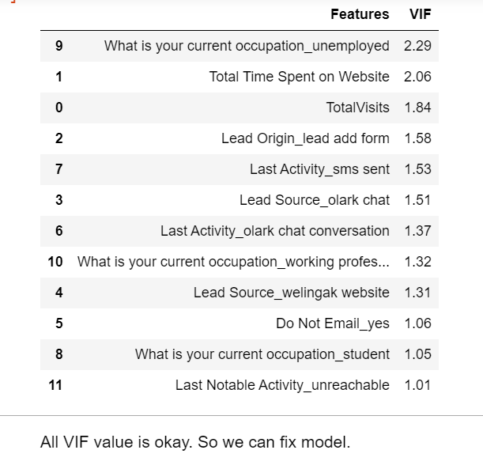
Model Building
Now we starting to build Model based upon train data set. For we find VIF in different different way to minimise P-value to better outcomes.

Slide 9
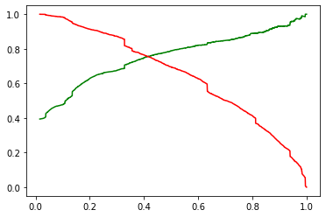
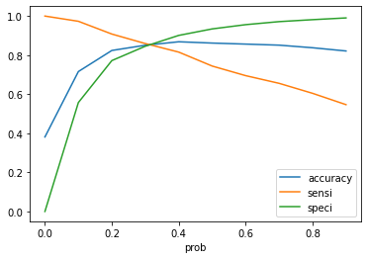
Evaluation Of Model( Test)
Accuracy, Sensitivity & Specificity
Precision & Recall

Slide 10
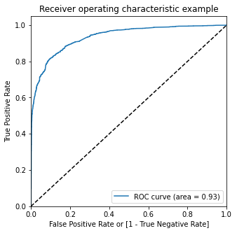
Evaluation Of Model( Train)
ROC
Accuracy, Sensitivity & Specificity

Slide 11
Observations
As per data set- Accuracy comes almost 81%, Sensitivity is 70% & specificity is around 87% @ cut off 0.42.
Precision comes around 79% & recall is 70%.
ROC curve comes .93.
It was found that the variables that mattered the most in the potential buyers are (In descending order) : -
The total time spend on the Website.
Total number of visits.
When the lead source was: Google , Direct Traffic , Organic Search, Welingak Website
Last activity was- SMS, Olark chat conversation.

Slide 12
Thank You

